Slide 1







Introduction to the ArcGIS API for Python
John Yaist
Nicholas Giner
2021 ESRI DEVELOPER SUMMIT

Slide 2
Target Audience
Experience with
organizations deployed to ArcGIS Online and/or ArcGIS Enterprise
Python
Interested in learning what the API for Python can do

Slide 3
Agenda – Part I
Define the ArcGIS API for Python
what it is
who it is for
description of modules
Access the ArcGIS API for Python
ArcGIS Pro community
Anaconda Distribution community
Using in Notebooks and IDEs
Demonstrate connecting, searching, publishing

Slide 4
ArcGIS API for Python
What is it?
Python library for spatial analysis, mapping and GIS
Powerful, modern and easy to use
Powered by Web GIS, with local capabilities
Made for AUTOMATION and DATA SCIENCE

Slide 5
ArcGIS API for Python and ArcPy
ArcGIS API for Python
ArcPy
Script against an organization:
Online or Enterprise
Use with services:
Analysis, Portal Admin, Content Creation, Big Data Analysis
ArcGIS Desktop
ArcMap – Python 2.x
ArcGIS Pro – 3.x
Local data
Mostly geoprocessing
Map automation

Slide 6
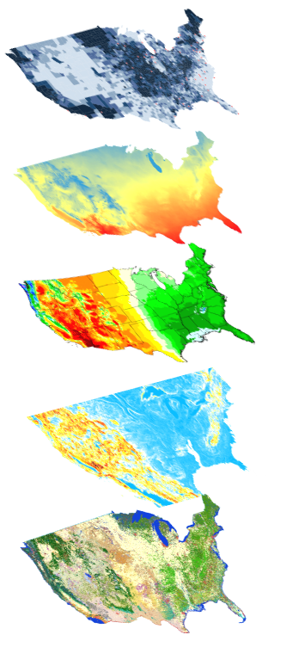
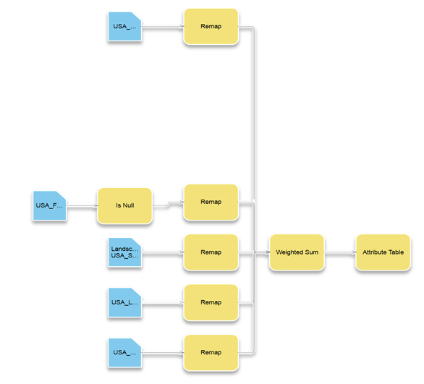
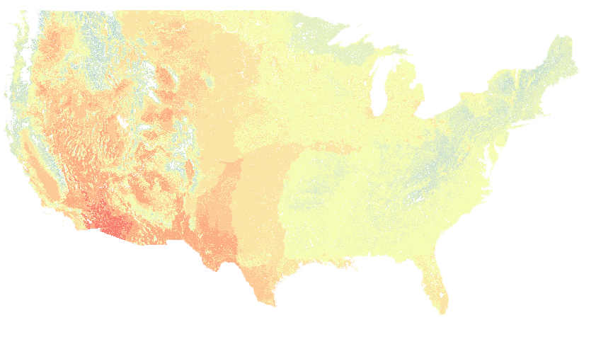

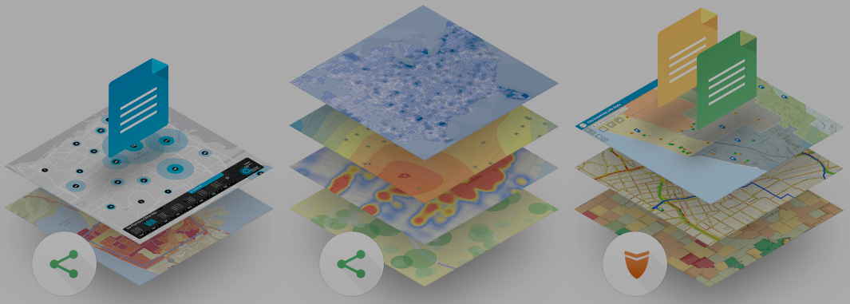
ArcGIS API for Python
Big Data
Spatial Analysis
Raster Analytics
What can it do for you?
Imagery
Location Analytics
Feature Analytics
Platform API
Power Users
Developers
Analysts
Data Scientists
Integration
Users, Roles & Group management
Administrators
DevOps
Content Publishers
Your Web GIS
A Pythonic representation of GIS
Data Management
Notes:
The API is for:
administrators and dev ops
admins: configuration, functioning, maintenance of various components, such as servers, data stores, web adaptors
dev ops: engineering, testing, release, life cycle
content publishers
adding items to the organization and sharing appropriately
analysts and data scientists
processing content to produce information products from various content
power users and developers
extending capabilities and building displays

Slide 7
API Overview
geo
analytics
geo
processing
geo
enrichment
gis
gis
geocoding
geometry
mapping
realtime
env
features
ogc
raster
widgets
schematics
network
apps
learn
Notes:
The API is distributed as the arcgis package via conda and pip.
Within the arcgis package, which represents the generic GIS model, functionality is organized into a number of different modules that makes it simple to use and understand. Each module has a handful of types and functions that are focused towards one aspect of the GIS.
The gis module is the most important and provides the entry point into the GIS. It lets you manage users, groups and content in the GIS. GIS admins spend a lot of time on this module.
The modules in green are used to access the various spatial capabilities or geographic datasets in the GIS. These modules include a family of analysis functions, types and other helper objects for working with spatial data of a particular type, including the apps module for accessing and managing web applications build with ArcGIS
The modules in blue provide additional functionality for your workflows.
geocoding module which is for finding places
geometry module for representing the geometries of feature data and functions for working with them,
geoprocessing module that makes it easy to import third party geoprocessing tools and work with them
geoenrichment module that helps you enrich your datasets with thematic information.
geoanalytics module to work with a distributed computing framework essential for big data processing - aggregation, regression, detection, clustering
The modules in orange allow you to visualize and disseminate your GIS data and analysis.
The widgets module includes the MapView Jupyter notebook widget for visualizing maps and layers,
the mapping module has types and functions for working with web maps and web layers

Slide 8
Getting the API
Multiple avenues to experience the API
Install and set up Guide: https://developers.arcgis.com/python/guide/install-and-set-up/
Focus: Distribution as a conda package named arcgis
ArcGIS Pro community
Python Geospatial and scientific community
Notes:
There are multiple ways to experience the ArcGIS API for Python. They are fully documented on the ArcGIS Developers Website in the Install and set up Guide at https://developers.arcgis.com/python/guide/install-and-set-up/.
To introduce the ArcGIS API for Python, we’ll focus on the distribution as a conda package named arcgis. Conda is a popular Python package and environment manager application that helps you install and update packages such as the ArcGIS API for Python and their dependencies. It extends the versatility of Python by allowing multiple installations of Python to coexist on a single workstation independent of one another. Each of these installations is referred to as a Python environment, and each environment has its own set of packages so you can switch between sets of Python functionality without enduring the installation process each time you want to use them.
Python in Pro: https://pro.arcgis.com/en/pro-app/latest/arcpy/get-started/installing-python-for-arcgis-pro.htm
Conda:
User Guide: https://docs.conda.io/projects/conda/en/latest/user-guide/index.html
Concepts: https://docs.conda.io/projects/conda/en/latest/user-guide/concepts/index.html
Managing Environments: https://docs.conda.io/projects/conda/en/latest/user-guide/tasks/manage-environments.html
ArcgIS Pro: https://pro.arcgis.com/en/pro-app/latest/arcpy/get-started/what-is-conda.htm

Slide 9
geo
analytics
gis
geo
processing
geo
enrichment
geocoding
raster
geometry
features
mapping
realtime
env
widgets
schematics
network
learn
apps

Slide 10

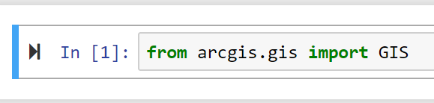


Using the GIS
The GIS class provides access to the
organization: system, users, content
Supports multiple logins methods
Leverages ArcGIS Pro Authentication
Used for security
Support profiles
Credentials do not get stored in scripts!

Slide 11
geo
analytics
gis
geo
processing
geo
enrichment
geocoding
raster
geometry
features
mapping
realtime
env
widgets
schematics
network
learn
apps

Slide 12
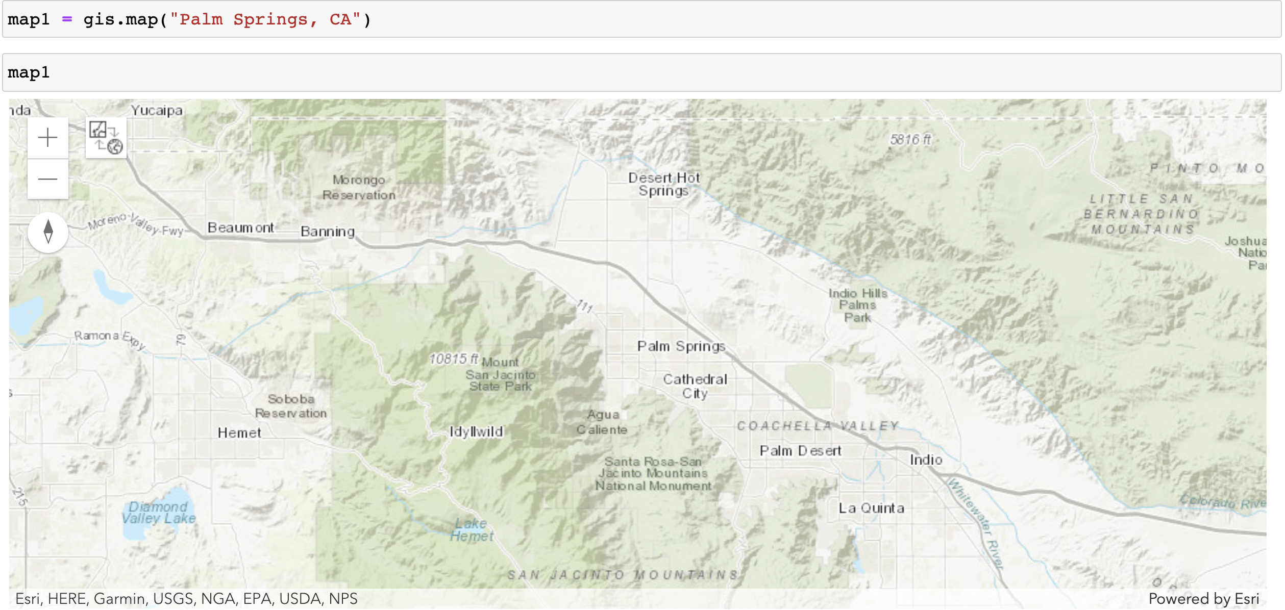
The Map Widget
geo
analytics
gis
geo
processing
geo
enrichment
geocoding
raster
geometry
features
mapping
realtime
env
widgets
schematics
visualization within Notebooks
network
learn
apps

Slide 13

Demo: Accessing and Using the API
ArcGIS Pro and Anaconda
Notebooks
IDE

